Slide 1
Filtering: frequency domain

Slide 2
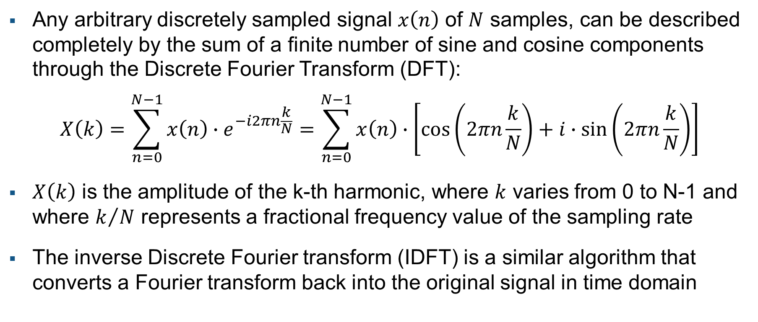
Frequency analysis and Fourier transform
Any arbitrary discretely sampled signal $x\left(n\right)$ of $N$ samples, can be described completely by the sum of a finite number of sine and cosine components through the Discrete Fourier Transform (DFT):
$$X\left(k\right)=\sum_{n=0}^{N−1}{x\left(n\right)∙e^{−i2πn\frac{k}{N}}}=\sum_{n=0}^{N−1}{x\left(n\right)∙\left[\cos\left(2πn\frac{k}{N}\right)+i∙\sin\left(2πn\frac{k}{N}\right)\right]}$$
$X\left(k\right)$ is the amplitude of the k-th harmonic, where $k$ varies from 0 to N-1 and where $k/N$ represents a fractional frequency value of the sampling rate
The inverse Discrete Fourier transform (IDFT) is a similar algorithm that converts a Fourier transform back into the original signal in time domain
Notes:
The Fourier transform converts a signal in the time domain into one in the frequency domain.
The inverse Fourier transform (IFT) is a similar algorithm that converts a Fourier transform back into the original signal

Slide 3
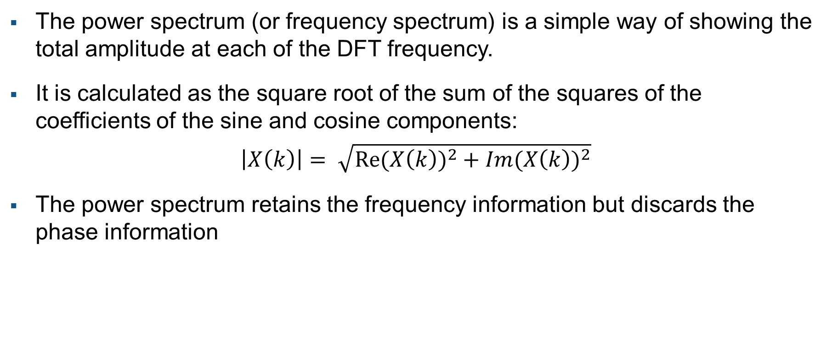
Power spectrum
The power spectrum (or frequency spectrum) is a simple way of showing the total amplitude at each of the DFT frequency.
It is calculated as the square root of the sum of the squares of the coefficients of the sine and cosine components:
$$\left|X\left(k\right)\right|= \sqrt{{\operatorname{Re}{(X\left(k\right))}}^{2}+{\operatorname{Im}{(X\left(k\right))}}^{2}}$$
The power spectrum retains the frequency information but discards the phase information
Notes:
The power spectrum (or frequency spectrum) is a simple way of showing the total amplitude at each of the DFT frequency

Slide 4
Frequency filtering
As in the time/spatial domain operations, two common goals of frequency-domain filtering and enhancement are:
noise reduction through low-pass filtering
sharpening through high-pass filtering
A frequency filter is performed by multiplying the frequency coefficients of the DFT of the signal, by some weights representing the frequency response of the filter.
The enhanced signal is then obtained by performing the inverse transform
Notes:
A frequency filter is performed by multiplying the frequency coefficients of the DFT of the signal, by some weights representing the frequency response of the filter

Slide 5
High-pass, low-pass and band-pass filters
Low-pass filter allow low frequency components, lower than the cut off frequency, to pass through and attenuate or eliminate the others
High-pass filter allow high frequency components above the cut off frequency to pass through and attenuate or eliminate others (lower than the cut off frequency)
Band-pass filter allows frequency within a certain range and attenuate or eliminate frequency outside that range
Notes:
Depending on the frequency components the filter will attenuate/enhance, the filter can be classified in low-pass, high-pass and band-pass filter.

